Slide 1

An Analysis of Mercury Levels in Alberta’s Fish
Justin Reinke

Slide 2
Introduction
The goal of this project is to analyze data provided by the Government of Alberta about the concentration of mercury (Hg) in the fish of Alberta. The dataset contains measurements of various species of fish in waterbodies and the concentration of mercury (Hg) in their tissue, measured by mg/kg.
An explanation of all the data columns can be found in the hg-in-fish-column-descriptions.xlsx file in the data folder in the GitHub repository. The hg-in-fish.xlsx file contains the data used for analysis. The source of the datasets can be found here: https://open.alberta.ca/opendata/chemical-monitoring-in-local-foods-mercury-in-fish.

Slide 3
Data Exploration

Slide 4
Data Characteristics
The data contain 25 columns and 6,373 rows; ~160,000 data points.
The Hg (mg/kg) column contains 6 null values; those rows were removed from the data. Hg (mg/kg) is the dependent variable being analyzed.
The data kept for analysis contained information on: Waterbody Name, Waterbody Type, Common Name, Sex, Fork Length (mm), Total Length (mm), Weight (g), Maturity, and Age (years).
The data were visualized to inspect the distribution shape and range, including outliers (Figure 1 and Figure 2).
A Q-Q probability plot was used to test for normality (Figure 3).

Slide 5
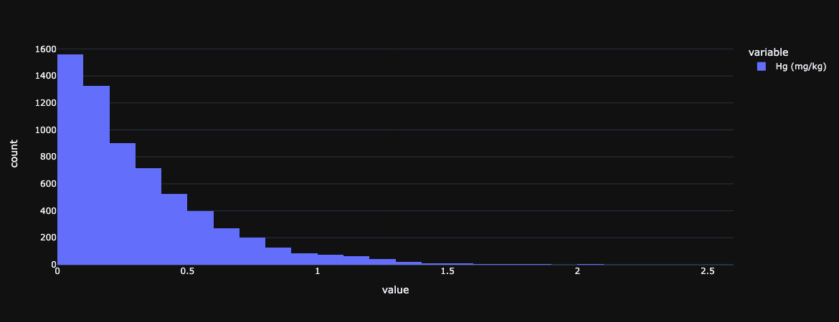
Figure 1: A histogram showing the values of Hg (mg/kg) and their distribution. The data are skewed right.

Slide 6
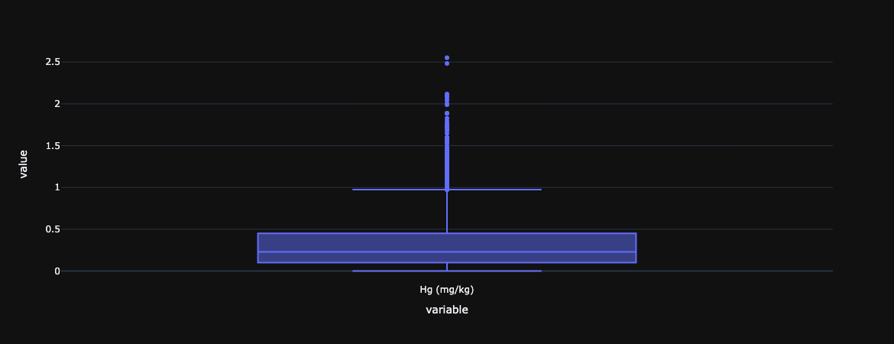
Figure 2: A boxplot showing the values of Hg (mg/kg) and their distribution. The data contain many outliers.

Slide 7
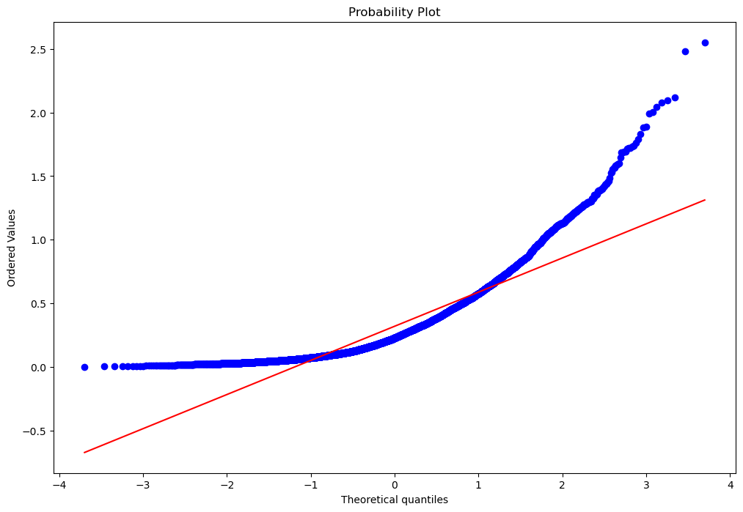
Figure 3: A Q-Q probability plot of the Hg (mg/kg) data. The data are not normally distributed.

Slide 8
Preparing the data
The Hg (mg/kg) data are right skewed and have many outliers, as shown by Figure 1 and Figure 2.
The Q-Q probability plot shows the data are not normally distributed (Figure 3).
The data might become approximately normal after a log10 transformation. The transformation may also eliminate most or all the outliers.

Slide 9
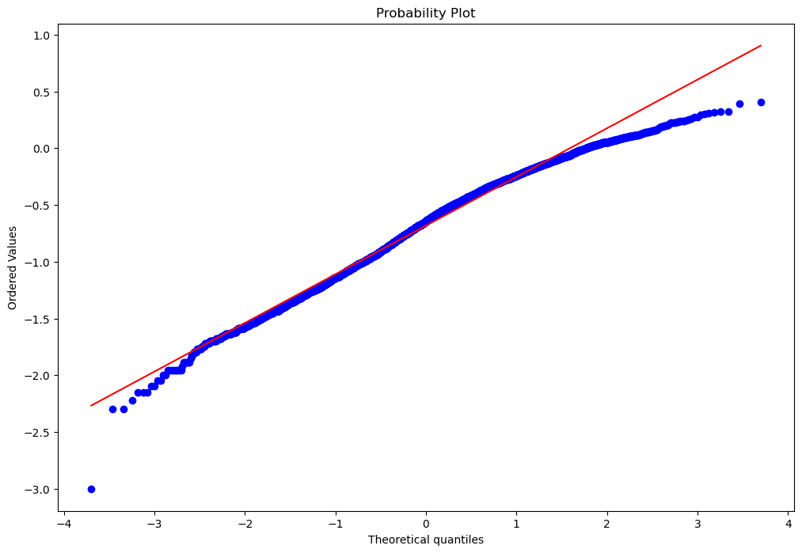
Figure 4: A Q-Q probability plot of the Hg (mg/kg) data after a log10 transformation. The data are approximately normally distributed.

Slide 10
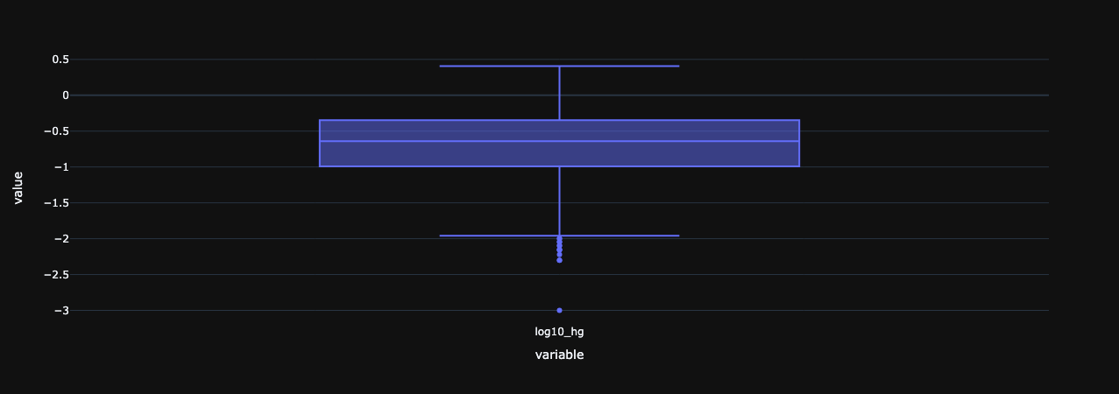
newplot.png
Figure 5: A boxplot showing the values of Hg (mg/kg) and their distribution after a log10 transformation. Some outliers remain.

Slide 11
Preparing the Data (cont.)
After the log10 transformation the data appear approximately normal (Figure 4) and most of the outliers have been removed (Figure 5).
While some outliers remain, they now represent a very small minority of the data points, approximately 0.2%.

Slide 12
Maturity and Hg (mg/kg) Analysis

Slide 13
Hypotheses
Null hypothesis: there are no significant differences between the means of Hg (mg/kg) in each Maturity group.
Hypothesis: there is a significant difference between the means of Hg (mg/kg) in each Maturity group. Mature fish will have a significantly larger concentration of Hg (mg/kg).

Slide 14
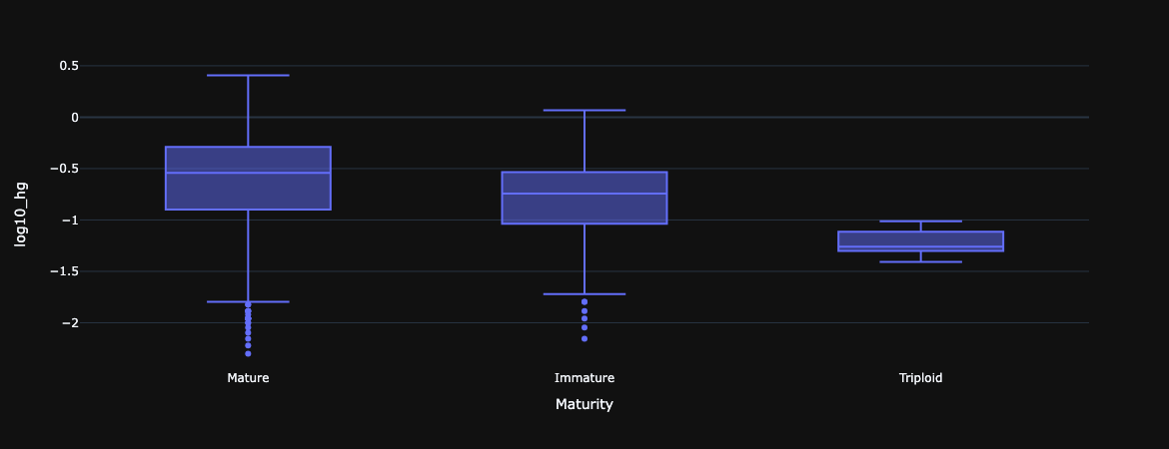
Figure 6: A boxplot of the groups identified in the ‘Maturity’ data. The boxplot shows the distribution of values of Hg (mg/kg) after a log10 transformation. The mature and immature groups still contain noticeable outliers; however, they represent a small percentage of the dataset.

Slide 15
Maturity Analysis
A one-way ANOVA was performed to compare the effect of maturity on the concentration of Hg (mg/kg). The ANOVA revealed that there was a statistically significant difference in Hg (mg/kg) between at least two groups; F(2, 3774) = 41.401, p < 0.001.
A post hoc Tukey’s HSD Test for multiple comparisons found that the mean value of Hg (mg/kg) was significantly different between mature and immature (p < 0.001), immature and triploid (p < 0.001), and mature and triploid (p < 0.001) groups. All means were significantly different from each other.
The means of Hg (mg/kg) in each group in maturity from largest to smallest are: Mature (M = 0.369 mg/kg), Immature (M = 0.228 mg/kg), and Triploid (M = 0.062 mg/kg)

Slide 16
Interpretation
The null hypothesis can be rejected in this case.
Mature fish had the highest concentration of Hg (mg/kg), followed by immature fish, and lastly triploid fish.

Slide 17
Weight (g) and Hg (mg/kg) Analysis

Slide 18
Hypotheses
Null hypothesis: there is no significant relationship between Weight (g) and Hg (mg/kg). Weight (g) will not significantly predict Hg (mg/kg).
Hypothesis: weight (g) will significantly predict Hg (mg/kg). As Weight (g) increases, the concentration of Hg (mg/kg) will significantly increase.

Slide 19
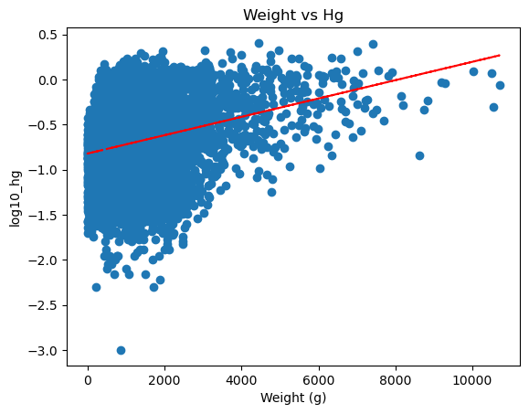
Figure 7: A scatter plot with trend line of the values of Weight (g) and Hg (mg/kg) after a log10 transformation. The trend line suggests a linear relationship between these variables potentially exists.

Slide 20
Weight Analysis
A scatter plot was created to investigate a possible linear relationship between Weight (g) and Hg (mg/kg); Figure 7. It appears there is a linear relationship between the variables.
A Pearson correlation was performed to assess the linear relationship between Weight (g) and Hg (mg/kg). There was a positive correlation between the two variables; r(6228) = 0.262, p < 0.001.
A simple linear regression was used to test if Weight (g) significantly predicted Hg (mg/kg). The fitted regression model was: Hg (mg/kg) = 0.0001 x Weight (g) + 0.440.
The overall regression was statistically significant; R² = 0.069, F(1, 6228) = 459.3, p < 0.001.

Slide 21
Interpretation
The null hypothesis can be rejected in this case.
The equation predicts a 0.0001 mg increase of Hg per one gram of weight increase. A one-kilogram increase in weight would result in a 0.1mg increase in the concentration of Hg.

Slide 22
Age (years) and Hg (mg/kg) Analysis

Slide 23
Hypotheses
Null hypothesis: there is no statistically significant relationship between Age (years) and Hg (mg/kg). Age will not significantly predict Hg (mg/kg).
Hypothesis: Age (years) will significantly predict Hg (mg/kg). As age increases, the concentration of Hg (mg/kg) will significantly increase.

Slide 24
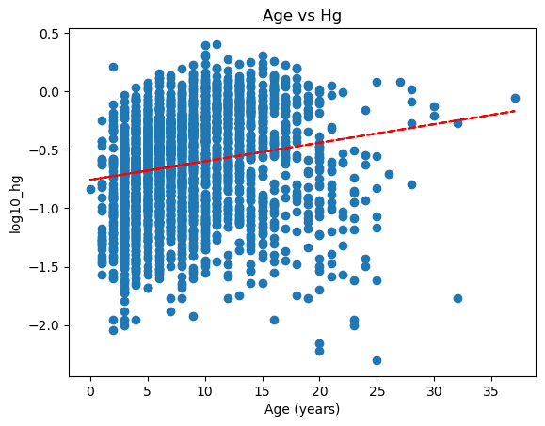
Figure 8: A scatter plot with trend line of the values of Age (years) and Hg (mg/kg) after a log10 transformation. The trend line suggests a linear relationship between these variables potentially exists.

Slide 25
Age Analysis
A scatter plot was created to investigate a possible linear relationship between Age (years) and Hg (mg/kg); Figure 8. It appears there is a linear relationship between the variables.
A Pearson correlation coefficient was computed to assess the linear relationship between Age (years) and Hg (mg/kg). There was a positive correlation between the two variables; r(2975) = 0.177, p < 0.001.
A simple linear regression was used to test if Age (years) significantly predicted Hg (mg/kg). The fitted regression model was: Hg (mg/kg) = 0.0159 x Age (years) + 0.469.
The overall regression was statistically significant; R² = 0.031, F(1, 2975) = 96.46, p < 0.001.

Slide 26
Interpretation
The null hypothesis can be rejected in this case.
The fitted regression equation predicts a 0.0159 mg/kg increase in Hg concentration per increase in age by one year.

Slide 27
Sex and Hg (mg/kg) Analysis

Slide 28
Hypotheses
Null hypothesis: There are no significant differences in the means of Hg (mg/kg) between sexes (male and female).
Hypothesis: The null hypothesis cannot be rejected, there are no significant differences in the means of Hg (mg/kg) between sexes (male and female).

Slide 29
Sex Analysis
A two-sample t-test was performed to compare the mean concentration of Hg (mg/kg) between female and male fish.
There was a significant difference in Hg (mg/kg) between the female group (M = 0.345 mg/kg) and the male group (M = 0.324 mg/kg); t(4537) = -3.726, p < 0.001.

Slide 30
Interpretation
The null hypothesis can be rejected.
Female fish have a significantly higher concentration of Hg (mg/kg) than male fish.
The average concentration of Hg (mg/kg) is 0.345 mg/kg for female fish and 0.324 mg/kg for male fish.

Slide 31
Sex and Weight (g) Analysis

Slide 32
Hypotheses
Null hypothesis: There are no significant differences in the mean weights between male and female fish.
Hypothesis: There is a significant difference between the mean weights between male and female fish. Female fish have a significantly larger mean weight than male fish.

Slide 33
Sex and Weight Analysis
A two-sample t-test was performed to compare the means of Weight (g) between female fish and male fish.
There was a significant difference between the female group (M = 1718.6g) and the male group (M = 1258.0g); t(4535) = -13.948, p < 0.001.

Slide 34
Interpretation
The null hypothesis can be rejected.
Female fish had a significantly larger mean weight (g) than male fish. Female fish had a mean of 1718.6g and male fish had a mean of 1258g.
The data are an aggregation of 22 species of fish sampled.

Slide 35
Sex and Age (years) Analysis

Slide 36
Hypotheses
Null hypothesis: There is no significant difference between the mean Hg (mg/kg) concentration of female and male fish.
Hypothesis: There is a significant difference between the mean Hg (mg/kg) concentration of female and male fish.

Slide 37
Sex and Age Analysis
A two-sample t-test was performed to compare the means of Age (years) between female fish and male fish.
There was a significant difference between the mean age of female (M = 8.02 years) and male (M = 8.97 years) fish; t(2967) = 5.417, p < 0.001.

Slide 38
Interpretation
The null hypothesis can be rejected in this case.
Male fish were found to be significantly older than female fish.

Slide 39
Fork Length (mm) and Hg (mg/kg) Analysis

Slide 40
Hypotheses
Null hypothesis: There is no significant relationship between Fork Length (mm) and Hg (mg/kg) concentration.
Hypothesis: There is a significant relationship between Fork Length (mm) and Hg (mg/kg) concentration. Fork Length (mm) will significantly predict Hg (mg/kg). As Fork Length (mm) increases the Hg (mg/kg) concentration will significantly increase.

Slide 41
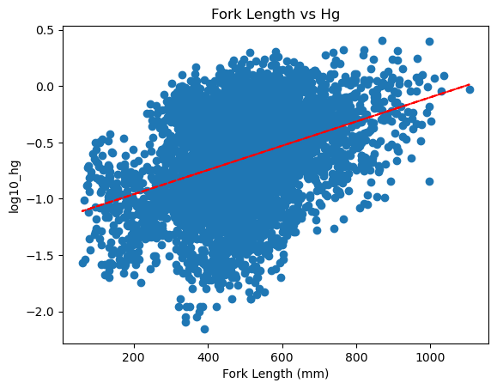
Figure 9: A scatter plot with trend line of the values of Fork Length (mm) and Hg (mg/kg) after a log10 transformation. The trend line suggests a linear relationship between these variables potentially exists.

Slide 42
Fork Length Analysis
A scatter plot was created to investigate a possible relationship between Fork Length (mm) and Hg (mg/kg); Figure 9. It appears there is a linear relationship between the variables.
A Pearson correlation coefficient was computed to assess the linear relationship between Fork Length (mm) and Hg (mg/kg). There was a positive correlation between the two variables; r(2975) = 0.375, p < 0.001.
Simple linear regression was used to test if Fork Length (mm) significantly predicted Hg (mg/kg). The fitted regression model was: Hg (mg/kg) = 0.0011 x Fork Length (mm) + 0.309.
The overall regression was statistically significant; R² = 0.141, F(1, 5282) = 863.5, p < 0.001.

Slide 43
Interpretation
The null hypothesis can be rejected in this case.
The regression predicts that every mm increase in fork length will result in a 0.0011 increase in the concentration of Hg.
An increase of 1cm would result in an increase of 0.11 mg/kg of Hg.

Slide 44
Total Length (mm) and Hg (mg/kg) Analysis

Slide 45
Hypotheses
Null hypothesis: There is no significant relationship between Total Length (mm) and Hg (mg/kg) concentration. Total Length (mm) will not significantly predict Hg (mg/kg).
Hypothesis: There is a significant relationship between Total Length (mm) and Hg (mg/kg) concentration; Total Length (mm) will significantly predict Hg (mg/kg) . As total length increases the Hg (mg/kg) concentration will significantly increase.

Slide 46
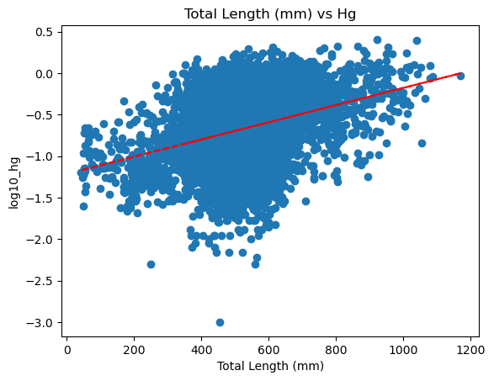
Figure 10: A scatter plot with trend line of the values of Total Length (mm) and Hg (mg/kg) after a log10 transformation. The trend line suggests a linear relationship between these variables potentially exists.

Slide 47
Analysis
A scatter plot was created to investigate a possible relationship between Total Length (mm) and Hg (mg/kg); Figure 10. It appears there is a linear relationship between the variables.
A Pearson correlation coefficient was computed to assess the linear relationship between Total Length (mm) and Hg (mg/kg). There was a positive correlation between the two variables; r(5171) = 0.356, p < 0.001.
A simple linear regression was used to test if Total Length (mm) significantly predicted Hg (mg/kg). The fitted regression model was: Hg (mg/kg) = 0.0010 x Total Length (mm) + 0.297.
The overall regression was statistically significant; R² = 0.126, F(1, 5171) = 748.1, p < 0.001.

Slide 48
Interpretation
The null hypothesis can be rejected in this case.
The regression predicts that every mm increase in total length will result in a 0.0010 mg/kg increase in the concentration of Hg.
An increase of 1cm would result in an increase of 0.10mg/kg of Hg.

Slide 49
Waterbody Type and Hg (mg/kg) Analysis

Slide 50
Hypotheses
Null hypothesis: There are no significant differences in the mean Hg (mg/kg) concentration of fish between any pair of waterbody types.
Hypothesis: There are significant differences in the mean Hg (mg/kg) concentration of fish in at least one pair of waterbody types.

Slide 51
Analysis
A one-way ANOVA was performed to compare the effect of waterbody type on Hg (mg/kg). A one-way ANOVA revealed that there was a statistically significant difference in Hg (mg/kg) between at least two groups; F(4, 6362) = 70.768, p < 0.001).
A post hoc Tukey’s HSD Test for multiple comparisons found that the mean value of Hg (mg/kg) was significantly different between all waterbody types (p < 0.001) except between Canal & River and Canal & Stormwater Pond.

Slide 52
Interpretation
The null hypothesis can be rejected in most instances in this case.
Waterbody Type: Reservoir (0.480 mg/kg), Lake (0.311mg/kg), River (0.268 mg/kg), Canal (0.120 mg/kg), Stormwater Pond (0.062 mg/kg).
See Figure 11.

Slide 53
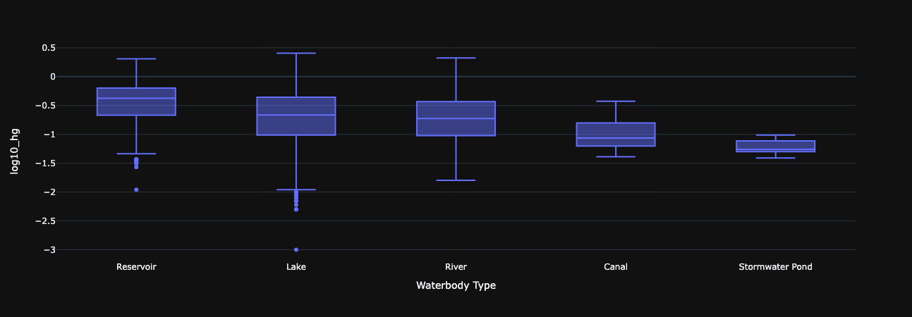
Figure 11: A boxplot of the groups identified in the ‘Waterbody Type’ data. The boxplot shows the distribution of values of Hg (mg/kg) after a log10 transformation. The reservoir and lake groups still contain noticeable outliers; however, they represent a small percentage of the dataset.

Slide 54
Exploratory Analysis
These analyses are informal, and no statistical tests were performed due to factors such as the large number of groups within a variable, the lack of a hypothesis that would be meaningful, etc.

Slide 55
Waterbody Names
There are a total of 142 waterbodies that were sampled in the dataset, thus a statistical analysis would be complex and not very meaningful.
The analysis was limited to which waterbody had the largest concentration of Hg (mg/kg) in its fish vs the smallest.
The highest concentration of Hg (mg/kg) was in Rolling Hills Lake (Rolling Hills Reservoir) at 1.09 mg/kg and the lowest Hg (mg/kg) was in McLeod Lake (Carson Lake) at 0.049 mg/kg.

Slide 56
Common Name of Fish
There are a total of 22 species of fish that were sampled in the dataset.
The analysis performed ordered the common names of those species of fish by largest mean concentration of Hg (mg/kg) to smallest and what consumption advice would be given based on the definitions in the 2019 Government of Alberta report. This is shown in Table 1.
If the concentration of Hg (mg/kg) was lower than 0.2 mg/kg, no consumption advice is given. Concentrations between 0.2 and 0.5 mg/kg are given “consumption limit” advice. Concentrations larger than 0.5 mg/kg are given “avoid consumption” advice.

Slide 57
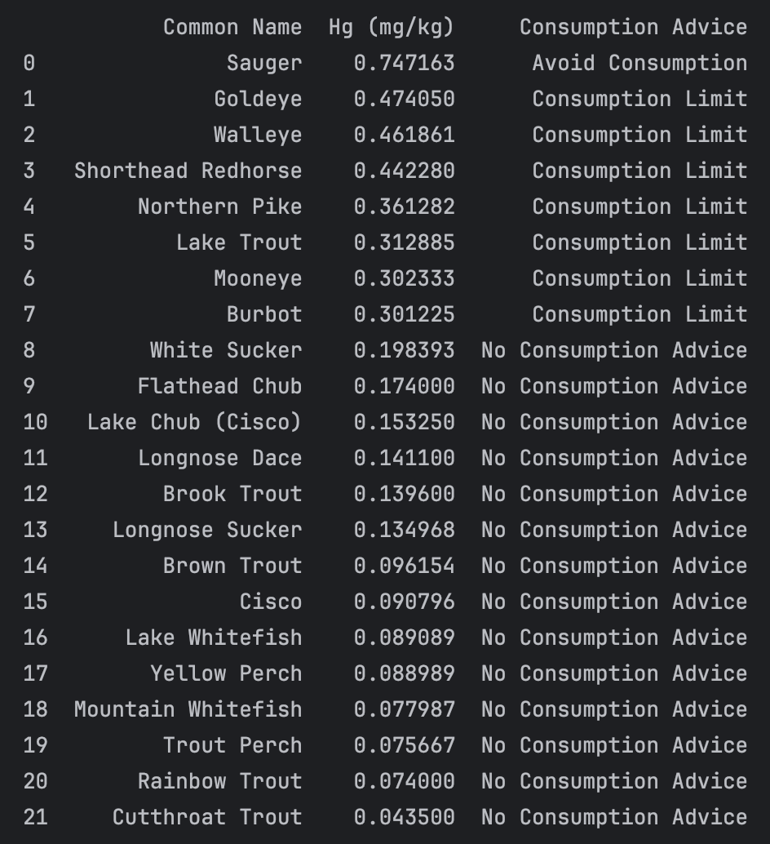
Table 1: Common names of species ordered by the average concentration of Hg (mg/kg) from highest to lowest. Consumption advice is taken from the guidelines provided in the Government of Alberta 2019 report referenced.

Slide 58
Results and Discussion
In general, the variables that influence the size and amount of tissue that a fish has were shown to significantly affect the concentration of Hg found in those fish; the larger the size, the higher concentration of Hg. These variables include Weight (g), Fork Length (mm), Total Length (mm).
Similarly, the variables that are associated with time were also shown to significantly affect the concentration of Hg in those fish. Those variables are Age (years) and Maturity. As age increases, the more accumulation of Hg will occur. Likewise, fish that are further along in their development will have a larger concentration of Hg than those that are not.
The Sex variable was significant in determining the concentration of Hg, which was not the expected result. This could be explained by sexual dimorphism, so further analysis was performed to determine if the means of Weight (g) were significantly different between female and male sexes. They were found to be significantly different, with female fish weighing significantly more than male fish.
The relationship between Sex and Age (years) was also analyzed to help describe this observation. Males were found to be significantly older than females on average. So sexual dimorphism could explain the higher concentration of Hg in females over males, but the extent of its influence could be hampered by the age of the fish. The interaction between Weight (g) and Age (g) and its effect on Hg (mg/kg) is not known. More research would need to be done, but the data seem to support this overall analysis.
Analyzing the Watertype variable gave results that generally aligned with the hypothesis tested. Waterbody types that have stagnated water (Reservoir and Lake) had significantly higher mean concentrations of Hg (mg/kg) in their fish than those that have moving water (River, Canal, and Stormwater Pond).

Slide 59
Results and Discussion (cont.)
There are 28 waterbodies you should avoid fishing in. These waterbodies have fish with an average of at least 0.5 mg/kg of Hg, which are given consumption advice of “avoid consumption” by the Government of Alberta; They are shown in Table 2.
There are a total of 22 species of fish sampled in the dataset. There is one species of fish that is given the consumption advice of “avoid consumption”. There are 7 species that are given the advice of “consumption limit”. Finally, there are 14 species that are given no consumption advice. This information is described in Table 3.

Slide 60
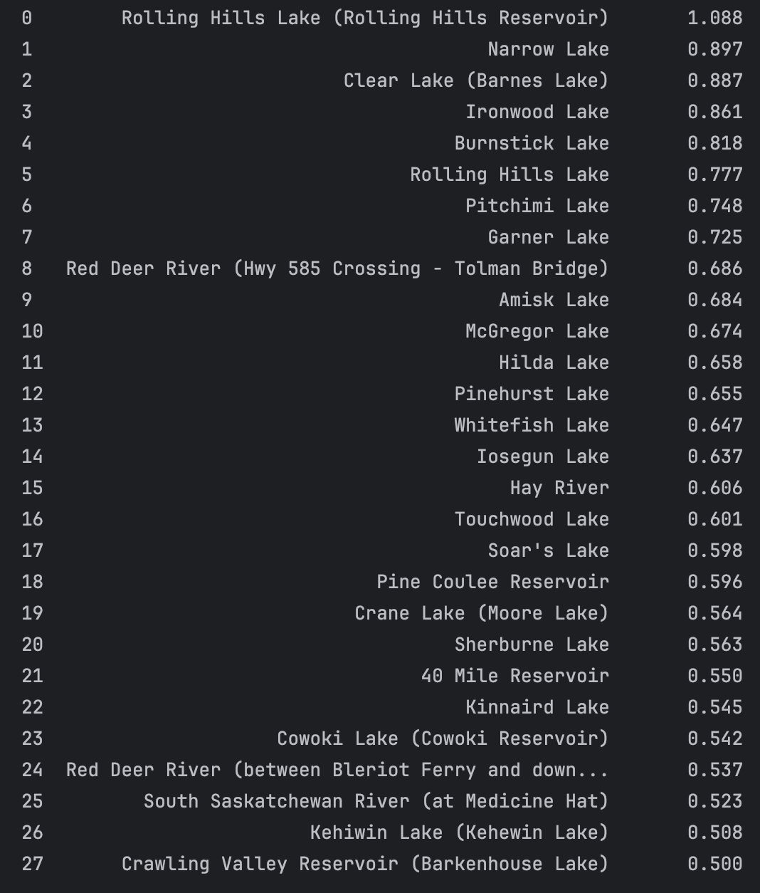
Table 2: Names of waterbodies and the average Hg (mg/kg) in fish found in those waterbodies which are 0.5 mg/kg or more.

Slide 61
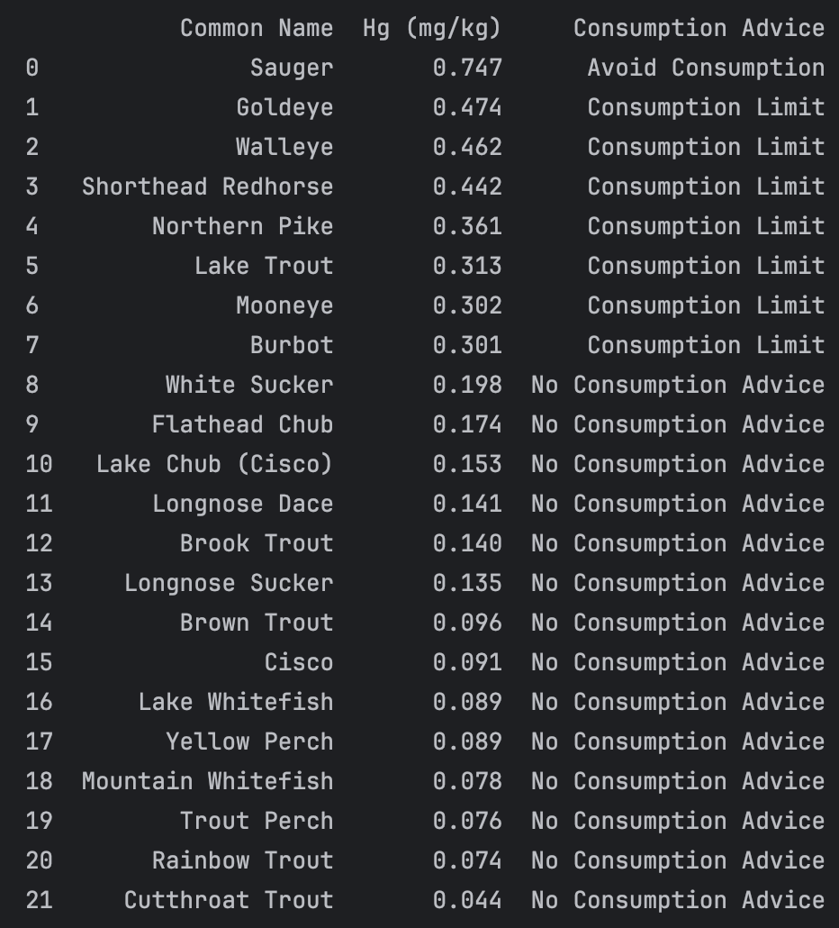
Table 3: A list of common names of fish sampled, their average Hg (mg/kg) concentration, and the consumption advice that is described by the Government of Alberta report referenced.

Slide 62
References
Alberta Health Environmental Public Health Science Team. (n.d.). Chemical Monitoring in Local Foods: Mercury in Fish—Open Government. Retrieved August 14, 2024, from https://open.alberta.ca/opendata/chemical-monitoring-in-local-foods-mercury-in-fish
Government of Alberta. (2019). Fish Consumption Guidance: Mercury in Fish. Environmental Public Health Science Unit, Health Protection Branch, Public Health and Compliance Division, Alberta Health. Edmonton, Alberta.

